Slide 1
PREDICTING HEALTH INSURANCE EXPENSES
Group 09
Notes:
Hello Everyone, my name is Farooq and I am representing Group 9. Our project is about using predictive modeling to estimate an individulal’s health insurance expenses

Slide 2
AGENDA
1. Introduction
2. Objective
3. Data Preprocessing
4. Exploratory Data Analysis
5. Modelling
6. Conclusion
Notes:
This is my agenda for the next 10 minutes, so please let me get started.

Slide 3
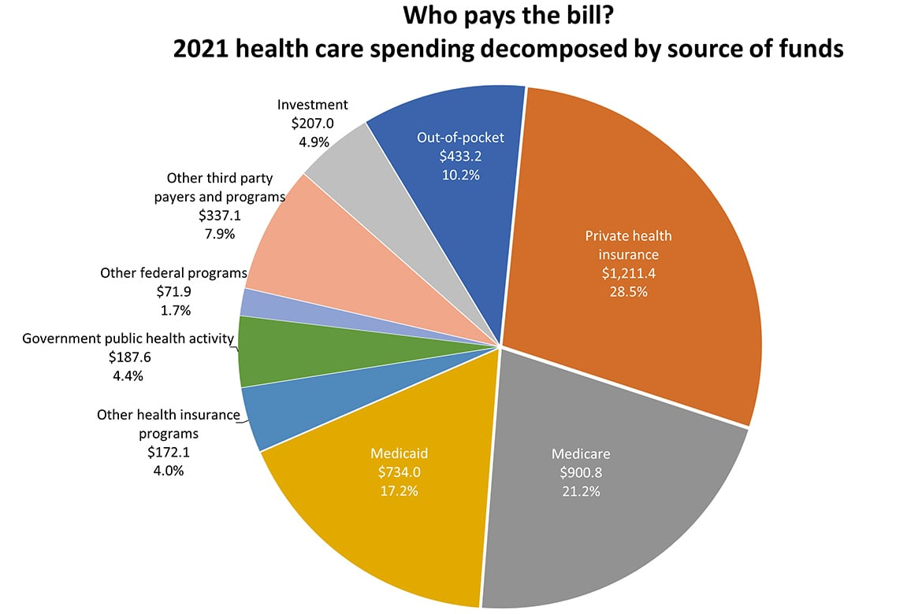


INTRODUCTION
Current Trends
In 2021, US Spent 18.3% of its GDP on Health care
Avg Health care expense - $12,914 per person
Predicting Healthcare expenses
Use historical data to create risk profiles
Set higher premiums for customers who fits the high risk profile
Direct Purchase
Employer-sponsored plans
Notes:
In the year 2021, The United States spent $4.3 trillion on healthcare expenditure. Which was 18.3% of the country's (GDP). This is the highest healthcare spending among developed countries
Now the health insurance industry, especially the new players, have been facing a number of challenges, which include - rising costs, increasing competition, low efficiency.
One of the ways a company can tackle these problems is with analytics. By analyzing historical data - the company can come up with different risk profiles and if a new customer fits a high risk profile, charge him a higher premium. This way the company can set fair prices while also making profit.

Slide 4
objective
To create a prediction model that estimates medical charges for a prospective customer based on their personal data
This model would help the Underwriting team to assess risk and set a fair and affordable premium price.
Notes:
Inspired by this my team took on the problem of developing a predictive model that can estimate heatlcare expense for a new customer based on their personal data.
This model would help the underwriting team, an underwriter is someone who works 1:1 with customers reviews their applications, assess their risk and decides what premium rate would be fair. Our model would help the underwriters speed up this process.

Slide 5
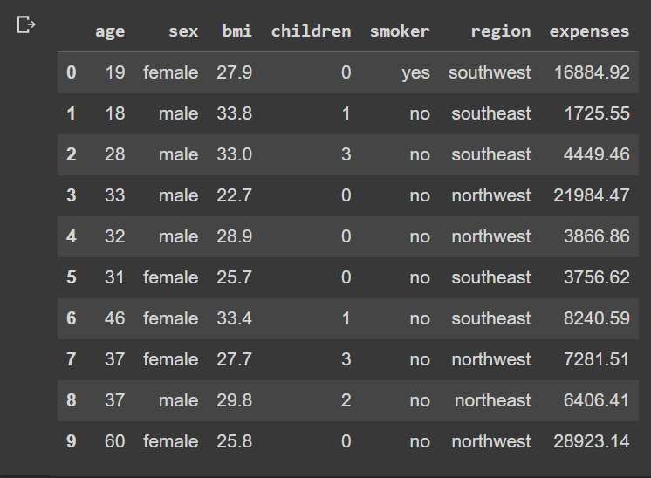
The data
According to the Author, this is a simulated dataset which has been created based on the information available on US Census site.
The Dataset has 7 columns and 1337 rows.
Notes:
Our dataset is not too huge, it has 1337 rows and 7 columns. This is historic customer data and each row corresponds to 1 customer. We have information on their age, sex, bmi, no of children, smoker, region, and finally their annual expense

Slide 6
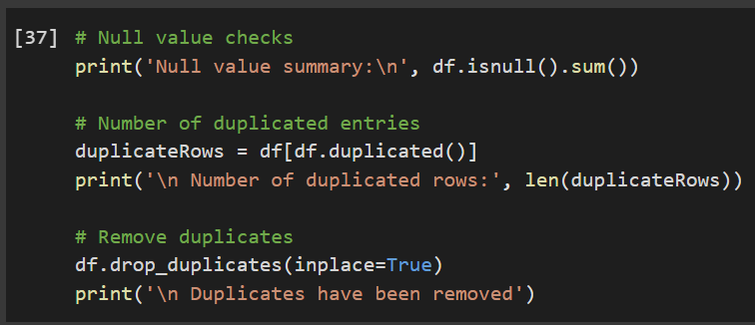
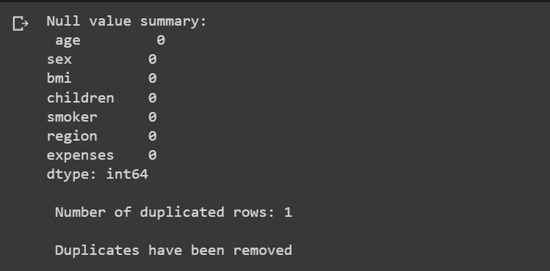
Data Preprocessing
1. Null value checks :
No Null values have been found.
2. Duplicate rows :
One duplicate row has been found and removed.
Notes:
The next step naturaaly was data preprocessing, I checked for null values and duplicate rows and dropped them.

Slide 7
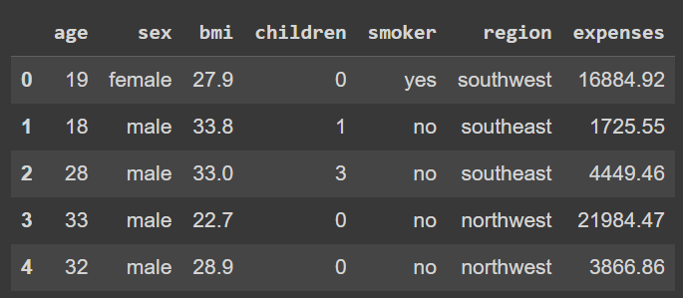
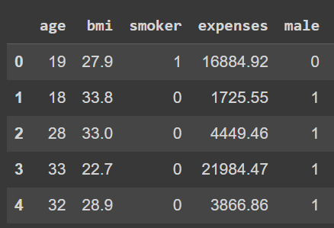
Data Preprocessing
Encoding Binary Variables:
Variables `sex` and `smoker` are binary variables, they have been encoded to indicators
Notes:
Next step was variable encoding, the variables sex and smoker were catogerical, so I used label encoding to encode them.

Slide 8
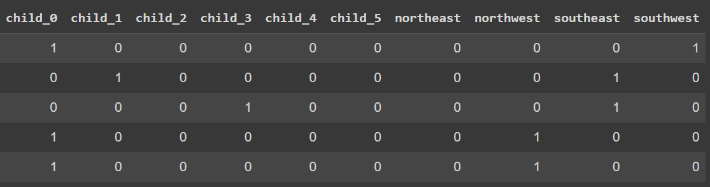
Data Preprocessing
One Hot encoding:
Variables `children` and `region` are numeric, and nominal variables.,
they have been transformed to one hot encoded variables
Notes:
The variabes children and region had more than 2 values so I used one hot encoding to create indicator variables. So that I could see the individual effects on each value on healthcare expense

Slide 9
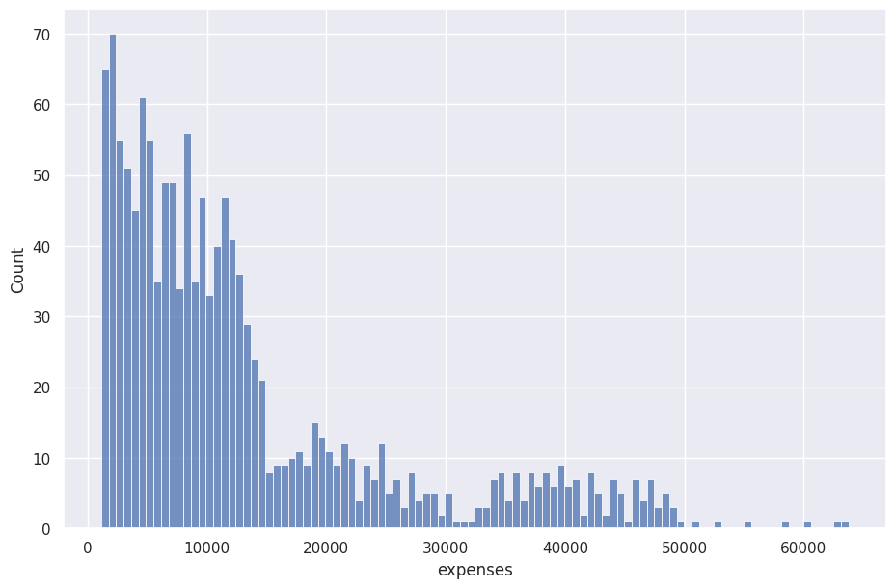
Data Preprocessing
Outlier removal:
7 outliers have been detected by Tukey’s
Outlier detection method and removed.
Notes:
During EDA I noticed some outliers, and I did not want my model to be effected by them, so I used Tukey’s outlier detection method to remove them

Slide 10
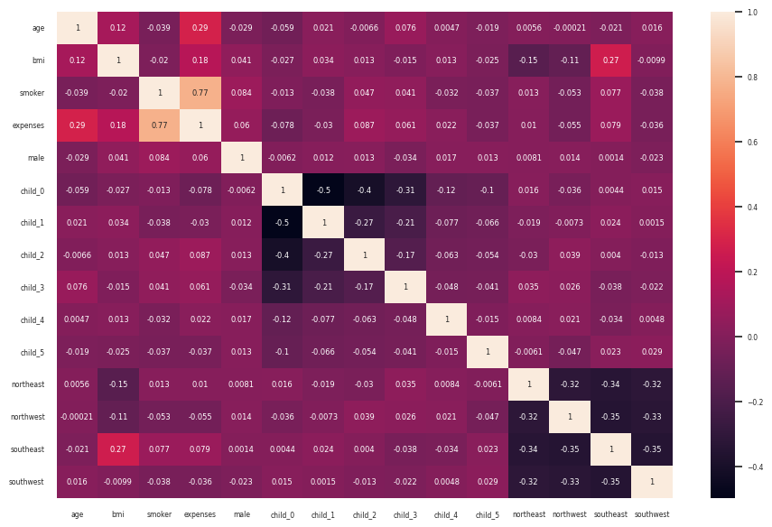
Exploratory data analysis
expenses
are highly correlated with
smoker, age, bmi
southeast seems to be correlated with bmi
Notes:
For EDA, I created a correlation heatmap and found that expense was correlated with age, bmi, smoker. It was also interesting to note the relatively high correlation between SE and BMI. These highlighted variables are what I am interested to look at

Slide 11
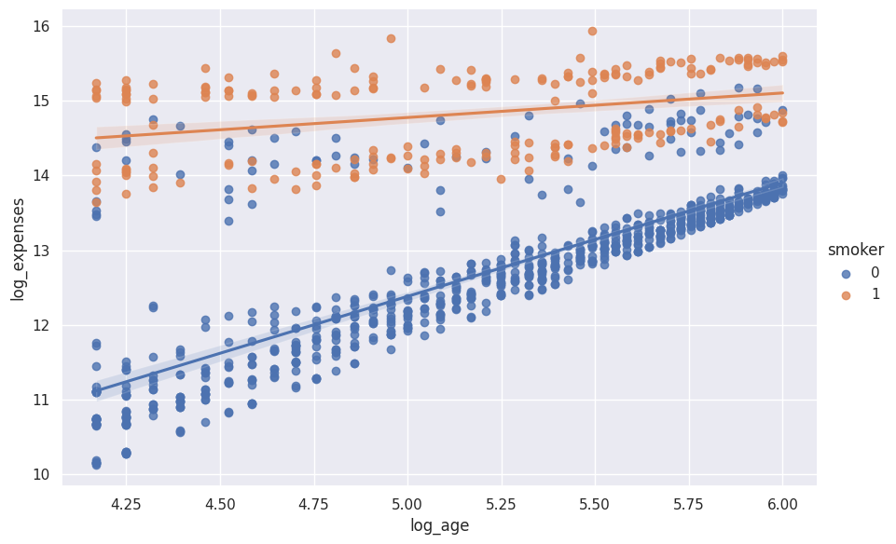
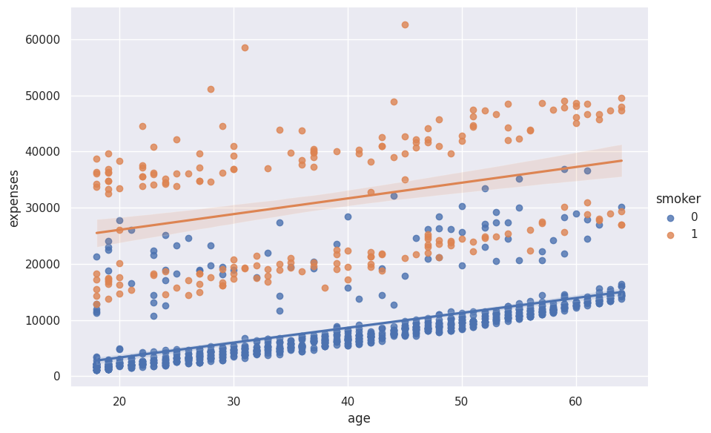
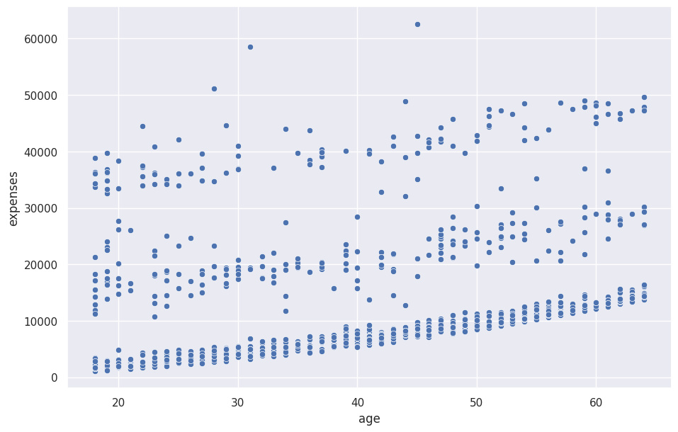
Exploratory data analysis
Age vs Expenses
BMI vs Expenses
Region vs BMI
Children vs Expenses
Notes:
First I looked at age vs expenses. We clearly see that with increasing trend, but we also see that there are 3 clusters. So I grouped this data by smokers and found that people who smoke have relatively higher expenses. But this was not the best fit, so I applied a log on both axes and it seemed to fit much better. I decided to go for a log model later.

Slide 12
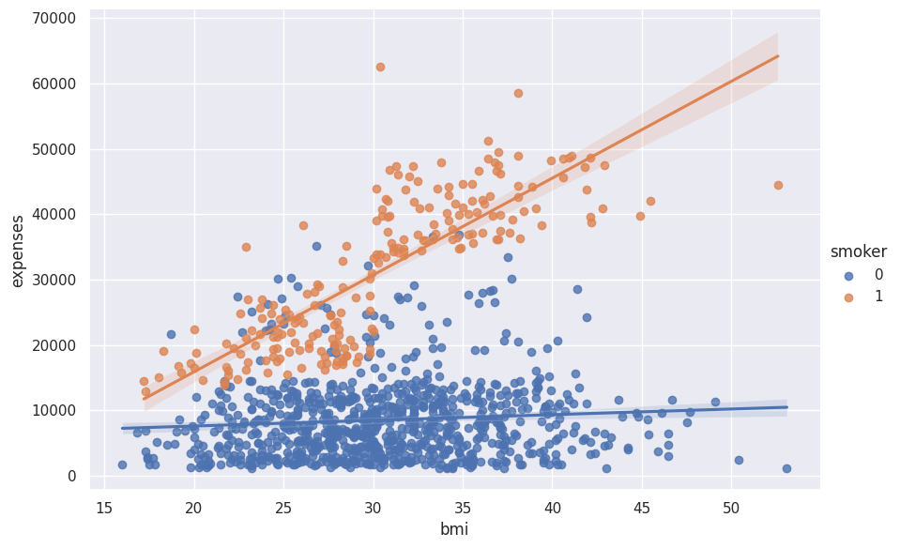
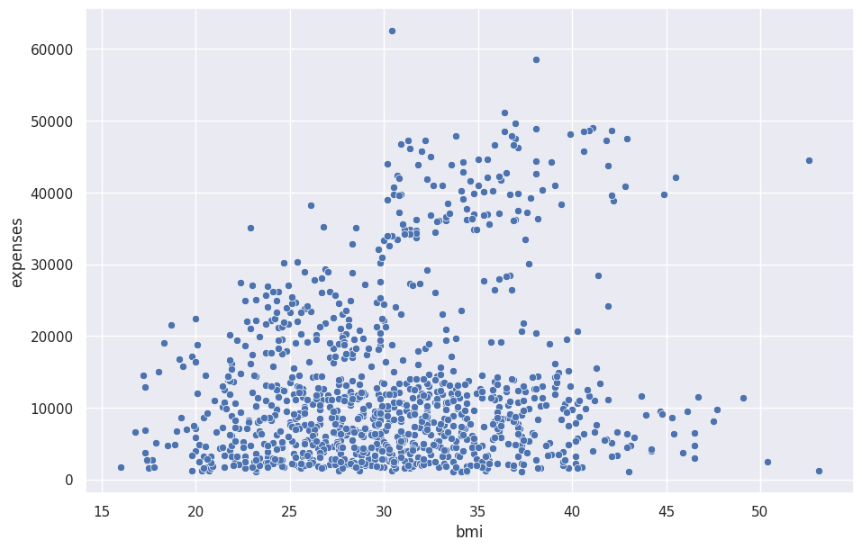
Exploratory data analysis
Age vs Expenses
BMI vs Expenses
Region vs BMI
Children vs Expenses
Notes:
Next variable was BMI, and now we see 2 groups, and the one above seems to have a higher slope. When I overlayed smoker status on this, it was clear that people who smoke, if they have a higher BMI their average expense is going up rapidly.

Slide 13
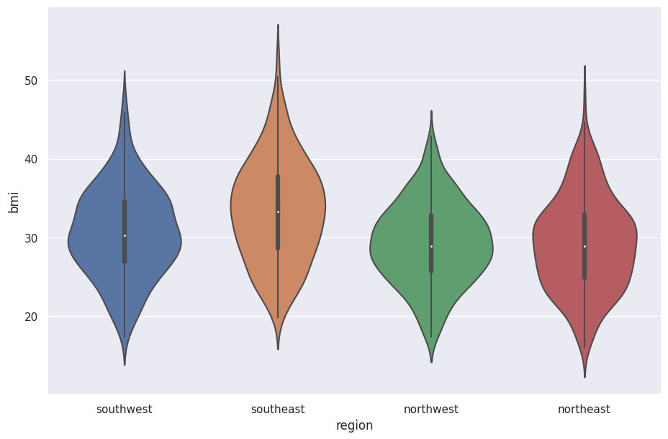
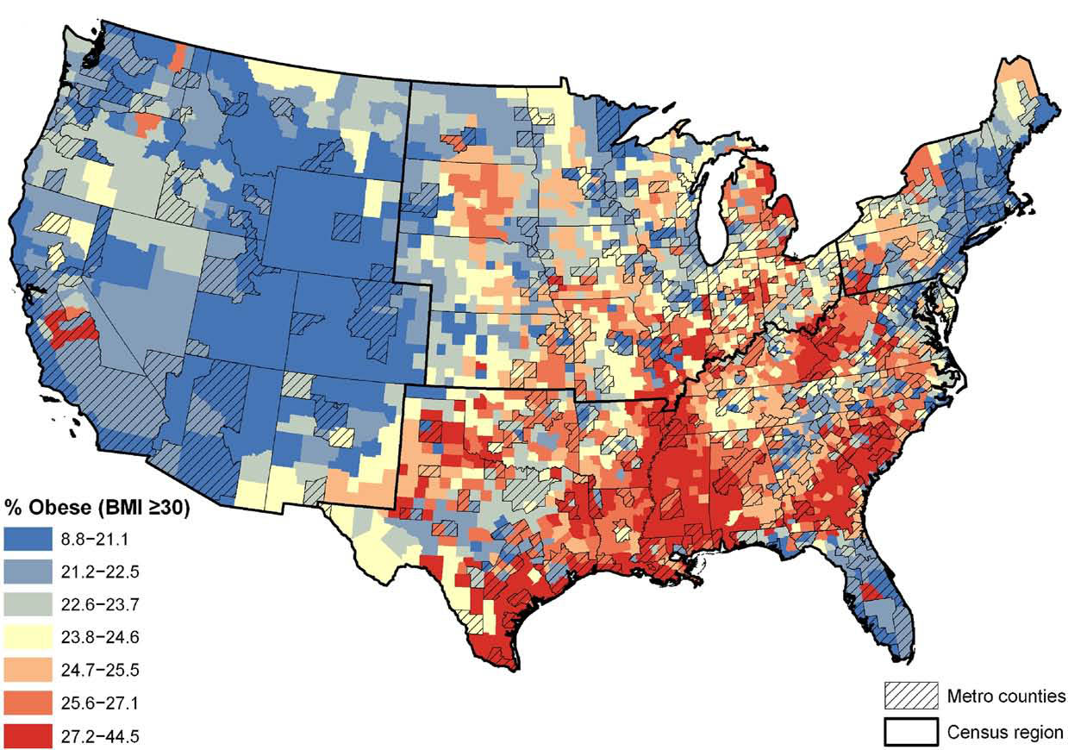
EXPLORATORY DATA ANALYSIS
Age vs Expenses
BMI vs Expenses
Region vs BMI
Children vs Expenses
Notes:
From the heatmap I was interested to see why southeast and BMI had high correlation and it turns out the SE has a higher median BMI, I corroborated this with data from CDC and it seems South east US infact has an higher avg BMI compared to other 3 regions

Slide 14
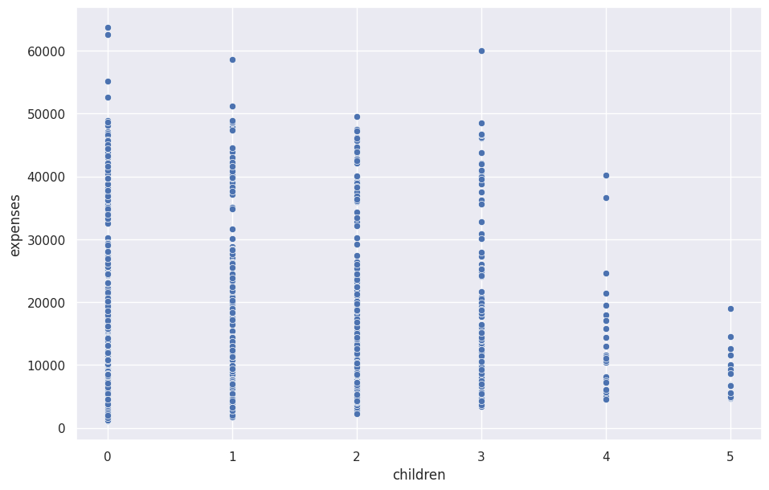
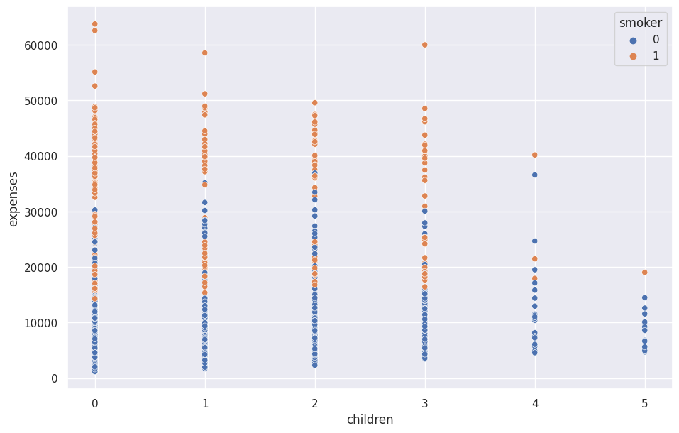
EXPLORATORY DATA ANALYSIS
Age vs Expenses
BMI vs Expenses
Region vs BMI
Children vs Expenses
Notes:
The last variable I wanted to look at was how number of children affected expenses. At a first glance it might look like people with less number of children have higher premium rates. But this isn’t quite true because most of our customers are have 0-3 kids and there are not many data points for 4-5. Not just that when I grouped this by smoker I again found that higher expenses belong to those who smokers.

Slide 15
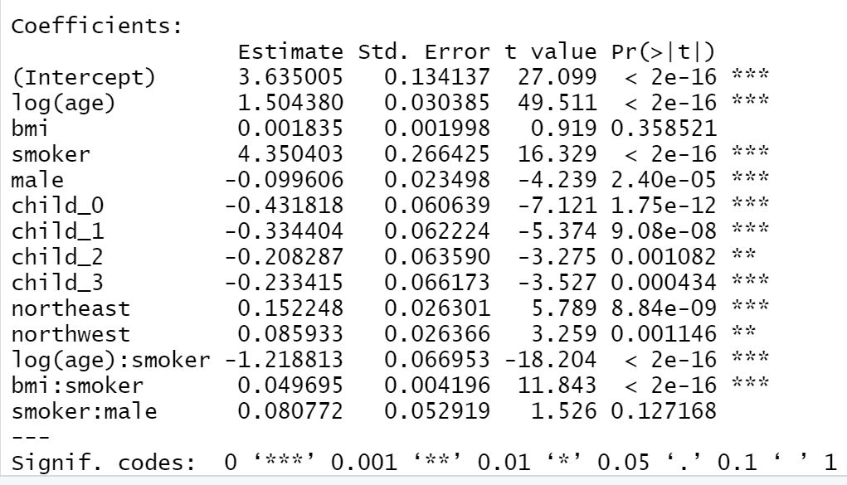
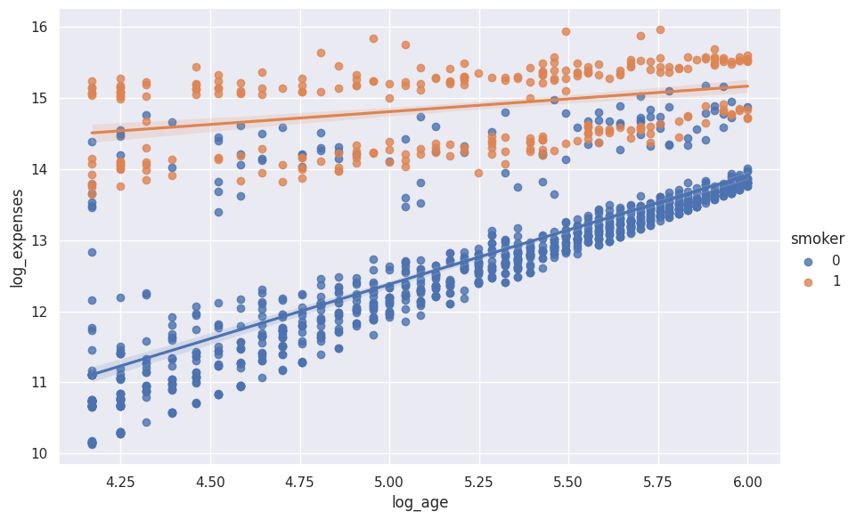
MODELING
log(expenses) = log(age) + bmi + smoker + male + child0​ + child1 ​+ child2 ​+ child3 ​​+ northeast + northwest + log(age):smoker + bmi:smoker + male:smoker
Notes:
Based on the relationships and interactions we have noticed, we came up with this multivariate linear regression model. I initially included a lot more variables but after running stepwise AIC this was the model I was left with. While it is a predictive model and the estimates are not for interpretation, Ive noticed that the estimates are not too far from that of my inferential model. So lets do some interpretation, for example if you lok at the coeff of log(age) – it measn that a 1% increase in age would cause a 1.5% increase in expense. Whereas if the person is a smoker

Slide 16
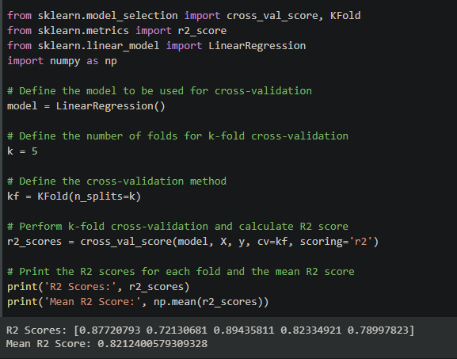
MODEL VALIDATION
5 – fold cross validation
Mean R squared = 0.82

Slide 17
LIMITATIONS
Limited and Historical Data
The dataset is small and has only few attributes about the customer.
Simple model
Linear regression is a simple model that may not be able to capture the complex relationship
Regulatory Compliance
Data privacy and adherence to FCRA and HIPAA regulations
Notes:
Not only the dataset is small, but it also doesn’t have important information like lifestyle habits, or past Healthcare utilization, also we need to keep updating our dataset with new data so that our model doesn’t become irrelevant.
Linear regression is a simple model that may not be able to capture non-linear relationships, more complex models can give better results at the cost of interpretability
Storing customer data implies that the company should invest in their data security team to avoid breaches and data governance team for the coapny to stay compliant with heatlcare regulatory bodies

Slide 18
CONCLUSION
This predictive model would be a great tool for :
Underwriting team : faster risk assessment and premium setup
Product dev team : to create new policies to fit customer needs
Customer relations team : targeted preventive care
Notes:
Overall predicitve modelling could bring great value to the company and help majority of our customers keep their insurance premiums low.

